Slide 1

Where Are You From? Confusing Location Distinction Using Virtual Multipath Camouflage
Song Fang, Yao Liu
Wenbo Shen, Haojin Zhu

Slide 2
Content
Location distinction
Virtual multipath attacks
Defense
Experiment
Summary
Notes:
Introducing a very interesting topic . It is about attack and defense.

Slide 3
Goal of location distinction
Detect a wireless user’s location change, movement or facilitate location-based authentication.

Slide 4
Applications:
Wireless sensor network: Location distinction can prevent an unauthorized person from moving the sensors away from the area of interest

Slide 5
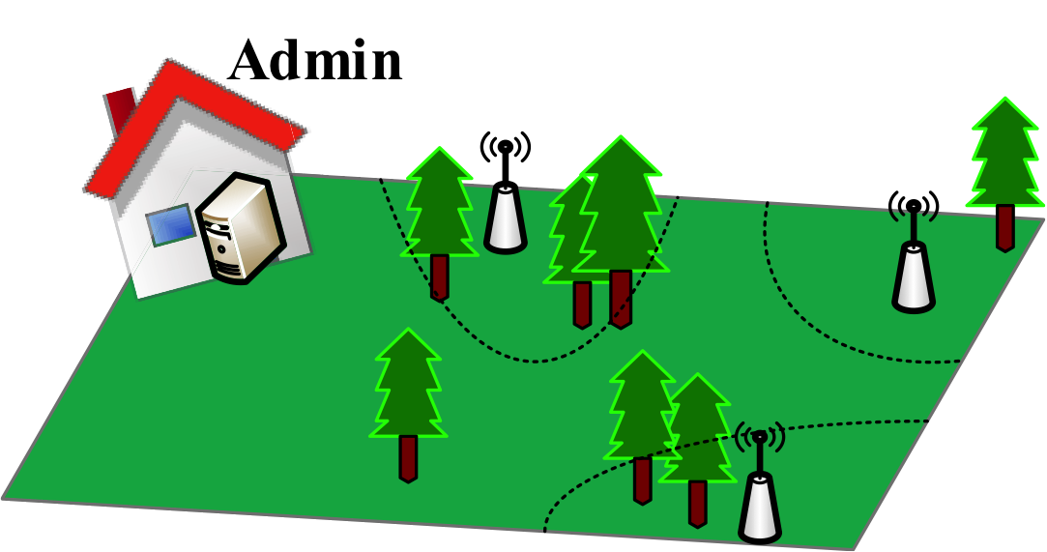
Example 1:

Slide 6
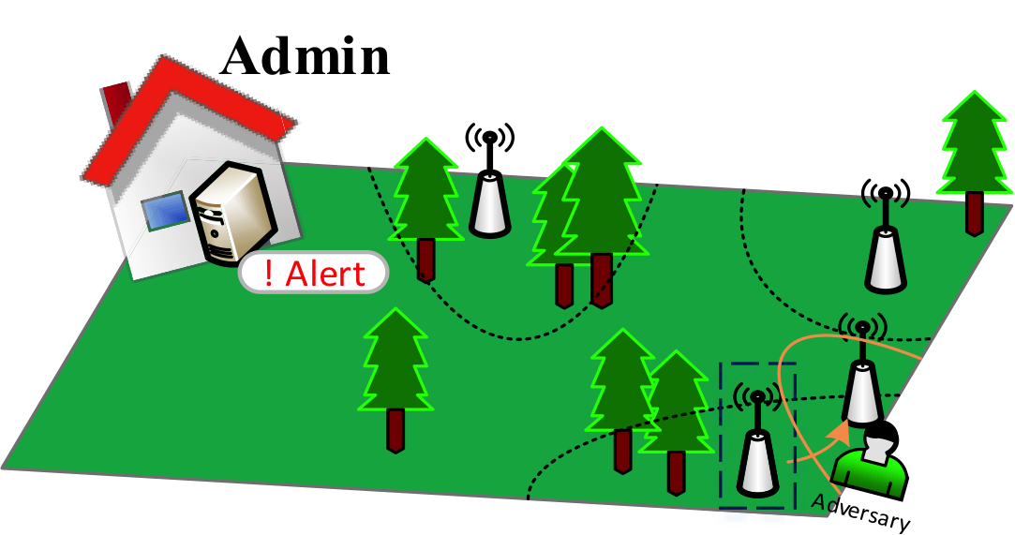
Example 1 (Cont’d):

Slide 7
Applications:
Wireless sensor network: Location distinction can prevent an unauthorized person from moving the sensors away from the area of interest
Sybil attack: Location distinction can detect identities originated from the same location

Slide 8
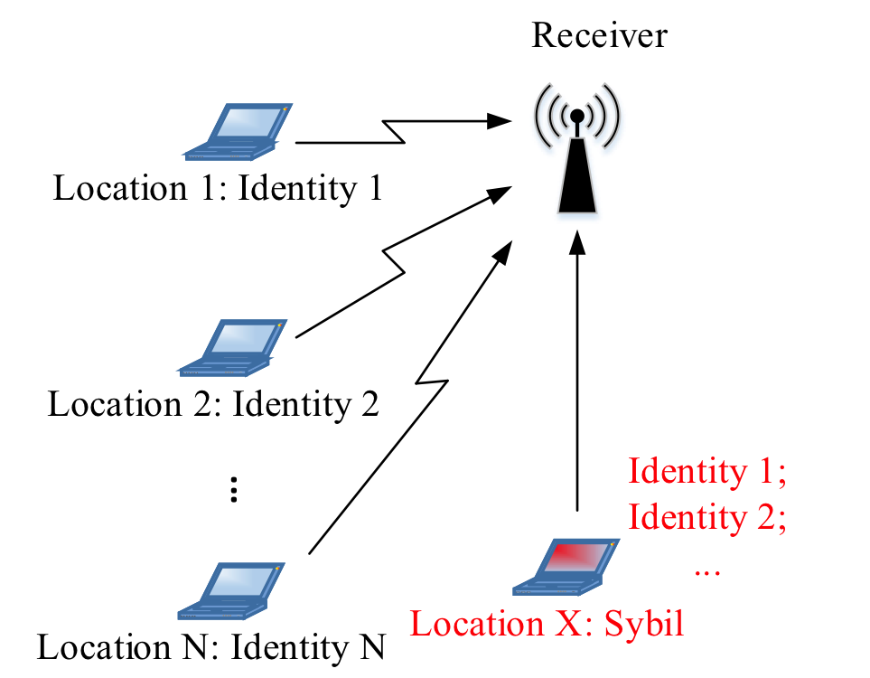
Example 2:

Slide 9
Example 2 (Cont’d):
From the same location
X

Slide 10
Applications:
Wireless sensor network: Location distinction can prevent an unauthorized person from moving the sensors away from the area of interest
Sybil attack: Location distinction can detect identities originated from the same location
RFID: Provide a warning and focus resources on moving objects (Location Distinction [MobiCom’ 07]).
Notes:
Besides, RFID tags are widely used for tracking inventory and maintaining the physical security.

Slide 11
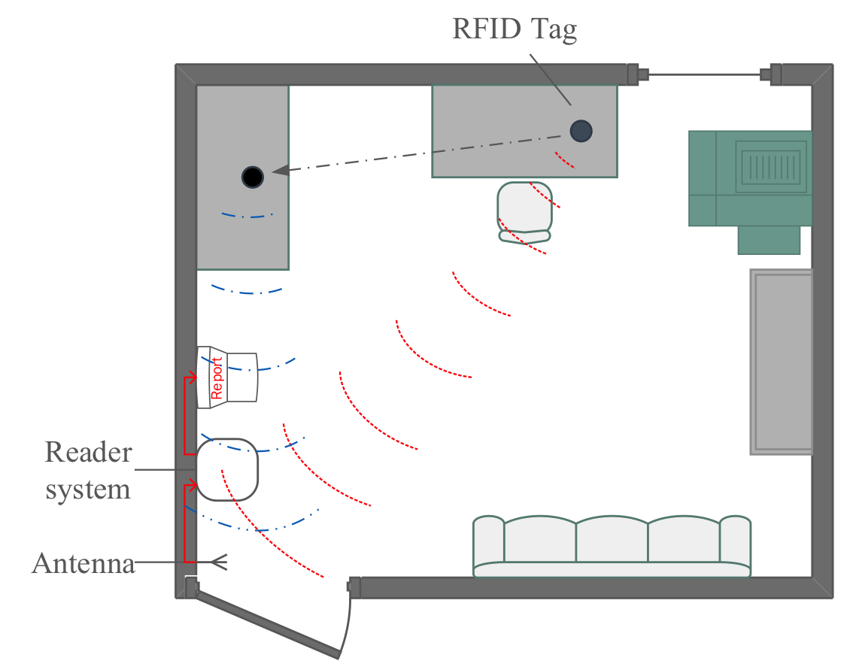
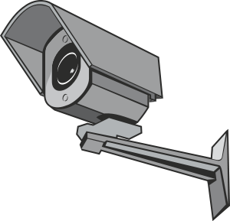
Example 3:
Move
Control
Notes:
Location distinction can provide a warning on moving objects and is helpful to allocate resources to be focus on moving objects, like the camera following the moving object as shown in the figure.

Slide 12
Example 3:
Move
Control

Slide 13
Existing ways to realize location distinction
Spatial uncorrelation property
Change
Wireless channel characteristics
Location change
Attack: Generate “arbitrary” characteristic
FAIL!!

Slide 14
Multipath effect
Multipath components
  Component response:
  Characterizes the distortion that each path has on the multipath component
Channel impulse response: The superposition of all component responses
Received signal
Transmitted signal
Notes:
And each path performs like a time and space varying filter, and distorts the multipath component.
The effect of such filter can be called as component response. In general, the component response characterizes the distortion that each path has on the multipath component.

Slide 15
Channel impulse response
  The channel impulse response changes as the receiver or the transmitter changes location
  Calculate the difference
Channel impulse responses can be utilized to provide location distinction.

Slide 16


Channel Estimation
Training sequence based channel estimation
Training Sequence x
Training Sequence x
x
y
x
Estimator
Channel Impulse response
h

Slide 17
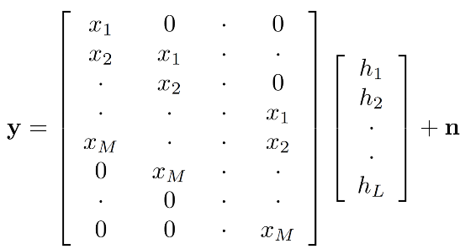
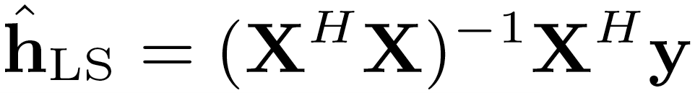
Channel Estimation (Cont’d)
  Rewrite the received symbols
A Toeplitz matrix
Least-square (LS) estimator
Notes:
Upper case

Slide 18
Content
Location distinction
Virtual multipath attacks
Defense
Experiment
Summary

Slide 19
Example: Creating a virtual multipath

Slide 20
Attack Overview: delay-and-sum process.
The attacker’s aims to make
The i^{th} delayed signal copy
Virtual channel impulse response

Slide 21
Technical Challenge: Obtaining the weights
Send the aggregated signal to the real multipath channel

Slide 22
Content
Location distinction
Virtual multipath attacks
Defense
Experiment
Summary
Notes:
In general, one key cannot open two doors at the same time.

Slide 23



Defending against the attack: Adding a helper
Notes:
Thus, a dramatic change of estimated channel impulse responses at the helper can indicate the potential existence of virtual multipath attacks.

Slide 24
Defending against the attack: Adding a helper
In this case, the attacker must know the real channel impulse response between herself and the helper.
Notes:
Similarly, if the attacker knows the real channel impulse between herself and the receiver’s helper and creates a virtual channel to fool the helper, the channel impulse responses estimated at the receiver side would be inconsistent.

Slide 25
Defending against the attack: Adding a helper
For Receiver:
For Helper:

Slide 26
Attackers with helper
To fool both the receiver and the receiver’s helper, the attacker needs to know the real channel impulse responses:
Unknown
Fail to launch attacks
Can be set passively: it doesn’t actively send out wireless signals to channel

Slide 27
Content
Location distinction
Virtual multipath attacks
Defense
Experiment
Summary
Notes:
About the experiment, we performed it outside our lab in USF.

Slide 28
Experiment floorplan
Transmitter: RX
Receiver: 10 locations
Each node: a USRP connected with a PC
Trials: 100 per location
Multipath: L=5
Notes:
The receiver estimates the channel impulse response from the received signals and verifies whether or not there is a location change by comparing a newly estimated channel impulse response with an old one. For each estimates, we perform 100 trails.

Slide 29
Example attacks I
Randomly chosen channel impulse response
^{Euclidean distance:}

Slide 30
Example attacks II
Recover another channel impulse response in another building (CRAWDAD data set^{[1]})
^{Euclidean distance:}
[1] SPAN, “Measured channel impulse response data set,” http://span.ece.utah.edu/pmwiki/pmwiki.php?n=Main.MeasuredCIRDataSet.

Slide 31
Overall attack impact
d_{est} = || chosen CIR - estimated CIR under attacks ||
d_{real} = || estimated CIR under attacks– real CIR ||
95%
5%
0.25
0.9
is much larger than
with high probability
Notes:
The attacker can drag the estimated value of channel impulse response far away from its true value and make it very close to her specified one.
With a carefully selected threshold, virtual multipath attacks make the location distinction false alarm rate to be very high.

Slide 32
Experiment floorplan
Helper
Attacker
Place the attacker and the helper at each pair of the 10 locations: 10×9=90 pairs.

Slide 33
Defense feasibility evaluation
The Euclidean distance between both estimates:
Attacker: Location 2
Receiver
Receiver’s helper (Location 8)
Notes:
The attacker launches the virtual multipath attack. Both the receiver and the helper do the channel estimation from two successive transmissions and then calculate the Euclidean distance between two estimates.
We can see that the distance at the receiver is very small so that it can not detect the virtual multipath attack by itself. However, at the helper, the distance d_helper is much larger so that the helper can effectively detect the attack.

Slide 34
Defense performance evaluation
Conclusion: The helper node is effective to help detect virtual multipath attacks.
Notes:
In terms of detection and false positive rates,
The helper may use a threshold to enforce the location. If the d_helper is larger than the threshold, the attack is assumed.
The detection rate is the probability that d_helper is larger than the threshold when there is indeed an attack.
The false positive rate is the probability that d_helper is larger than the threshold when there is no attack.

Slide 35
Content
Location distinction
Virtual multipath attacks
Defense
Experiment
Summary

Slide 36
Summary
We identified a new attack against existing location distinction approaches that built on the spatial uncorrelation property of wireless channels.
We proposed a detection technique that utilizes a helper receiver to identify the existence of virtual channels.

Slide 37
Thank you!
Any questions?

